Slide 1
FACIAL RECOGNITION /
PATIENT IDENTIFIER

Slide 2
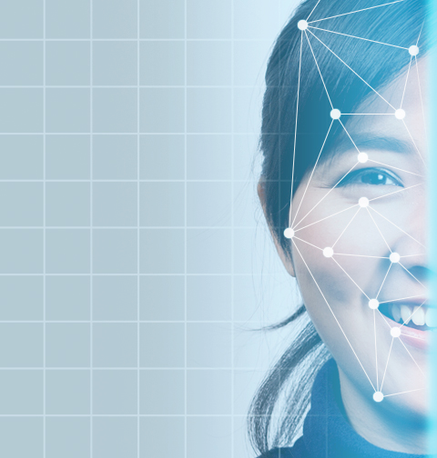
What is facial recognition?
Facial Recognition is an analytics feature that identifies and authenticates a specific person from an image or video based on their facial features.
The GoodX Web App uses biometrics to map the geometry of the face. When the results of this scan are cross-referenced, it quickly confirms a patient’s identity on the system.

Slide 3
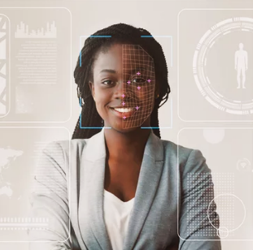
How does the Patient Identifier work?
Install a quality web camera at the reception desk or make use of the myGC Kiosk.
When a new patient arrives at the practice, take a clear picture of them with the web camera and save it to their patient file.
When an existing patient arrives at the practice, use the Patient Identifier feature to scan their facial features.
Click here to read the Patient Identifier user manual.

Slide 4
Benefits of the Patient Identifier
For the practitioner:
Improved practitioner-patient relationship.
Ensure that the correct patient is being treated.
Secured access to medical software and database.
Secured access to classified clinical and medical information.

Slide 5
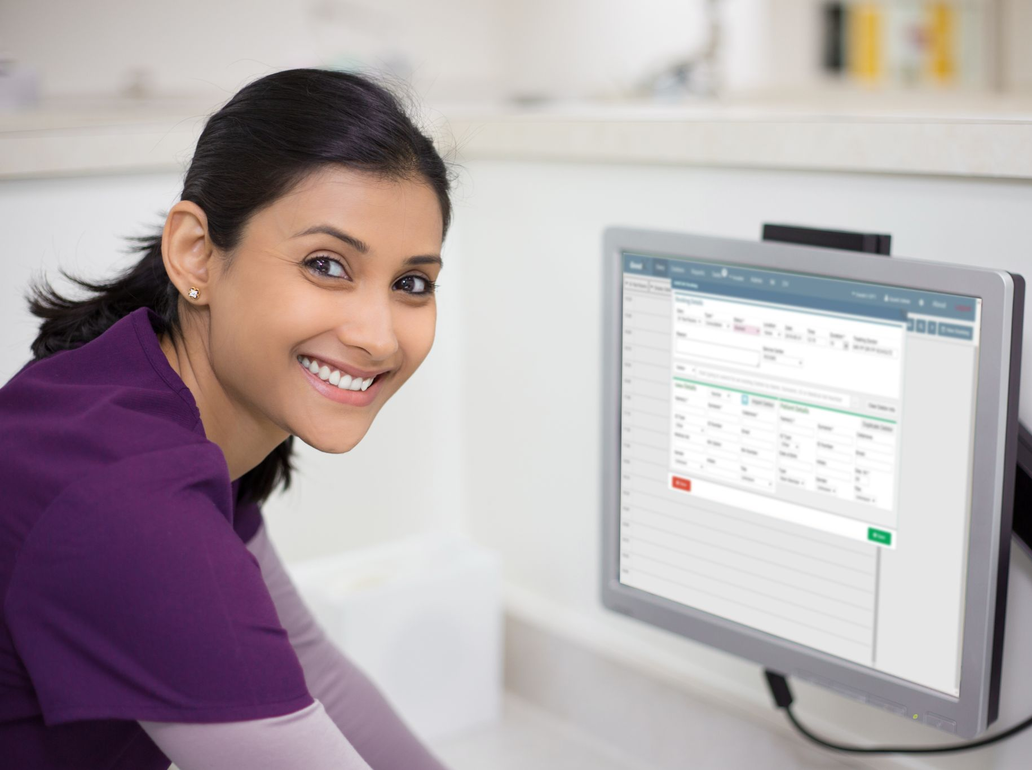
Benefits of the Patient Identifier
For the receptionist:
Efficient patient flow.
Know that the patient file is correct.
Avoid the risk of duplicate patient files.
Improved patient relationship with the practice.
POPI Act compliance due to increased security measures.

Slide 6
Benefits of the Patient Identifier
For the patient:
Prevent identity theft.
Improved patient experience.
Increased trust in the practice.
Improved patient-practitioner relationship.
Increased security of classified personal information.

Slide 7
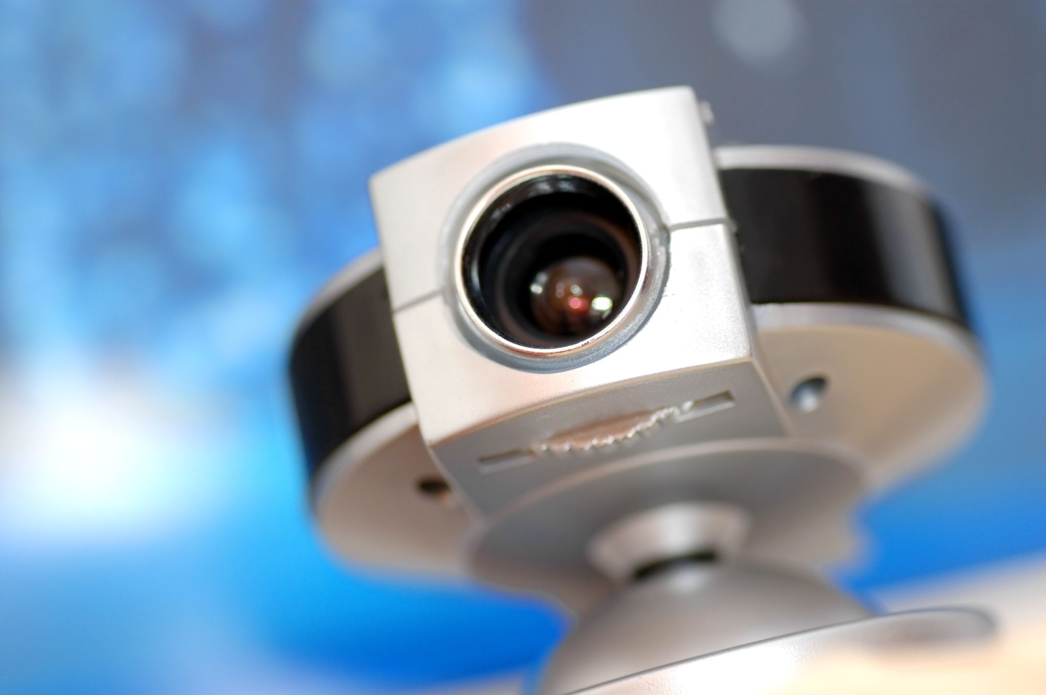
Hardware requirements
A USB web camera that is able to take clear pictures.
Preferably full high definition (FHD / 1080p) which is 1280 x 720 pixels.
Or a myGC Kiosk.
Click here to learn more about the myGC Kiosk.

